Slide 1
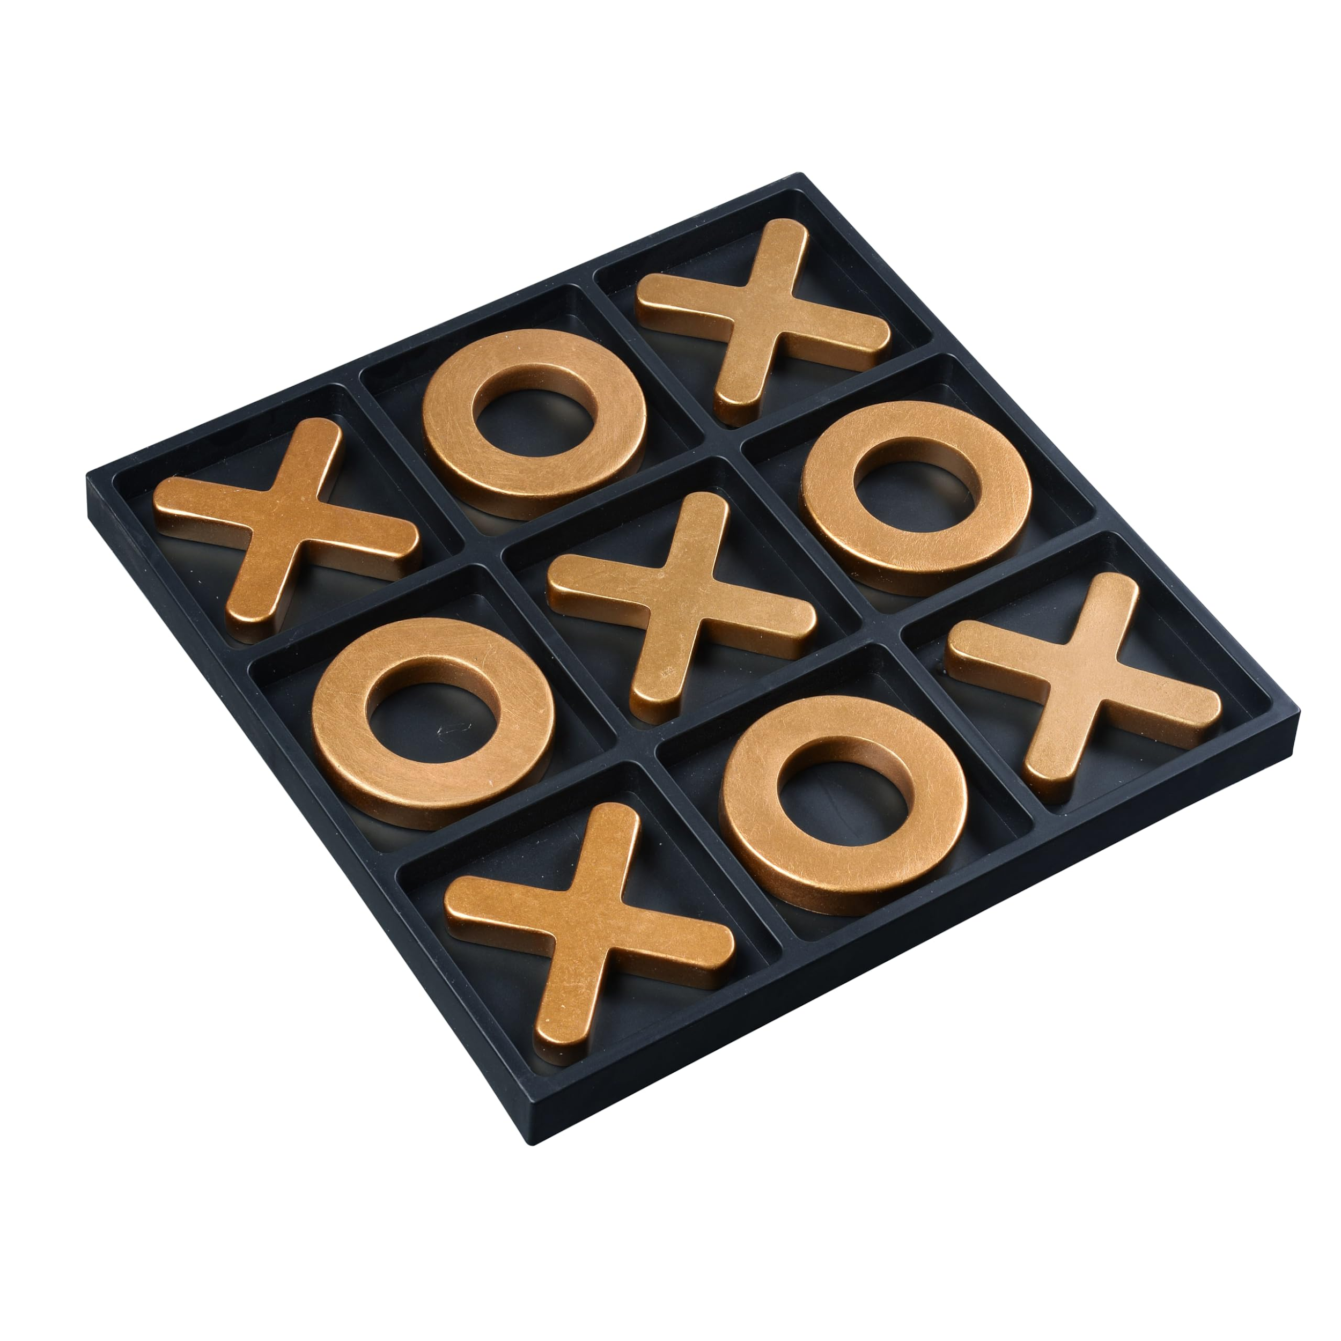
TIC-TAC-TOE
NAME- CH ADI CHARAN
MICRO IT PROJECT - TIC-TAC-TOE

Slide 2
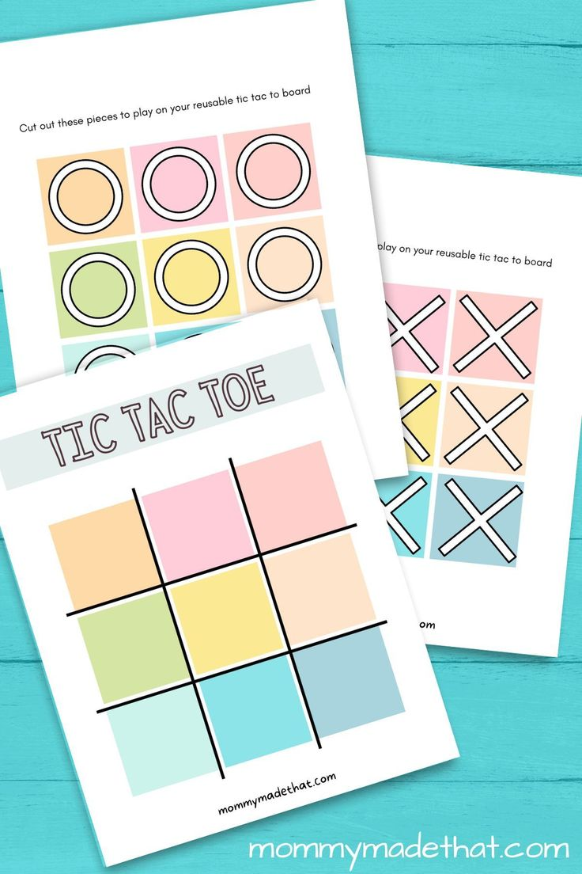
Introduction
Tic-Tac-Toe is a timeless and simple strategy game that has been used for years as a beginner-level programming project to introduce logic building, user interface design, and event handling. During my internship, I was tasked with creating a fully functional version of Tic-Tac-Toe that supported interactive play, intuitive design, and efficient logic. This project helped me strengthen my skills in programming, game development, and software design principles.

Slide 3
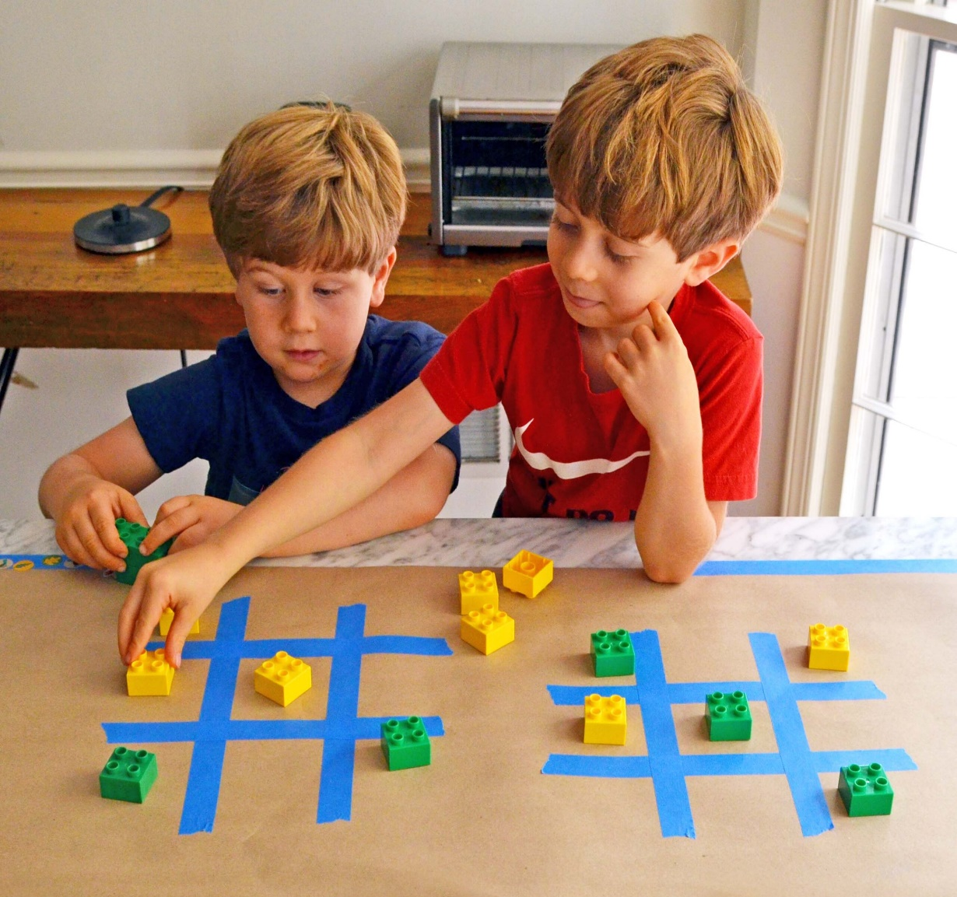
Objective of the Project
The primary goal of this project was to : Understand the software development life cycle by creating a simple yet complete application. Implement core programming concepts like conditionals, loops, functions, and arrays. Learn basic game development and UI/UX concepts. Provide an interactive platform that allows two users to play the game on a single device.

Slide 4
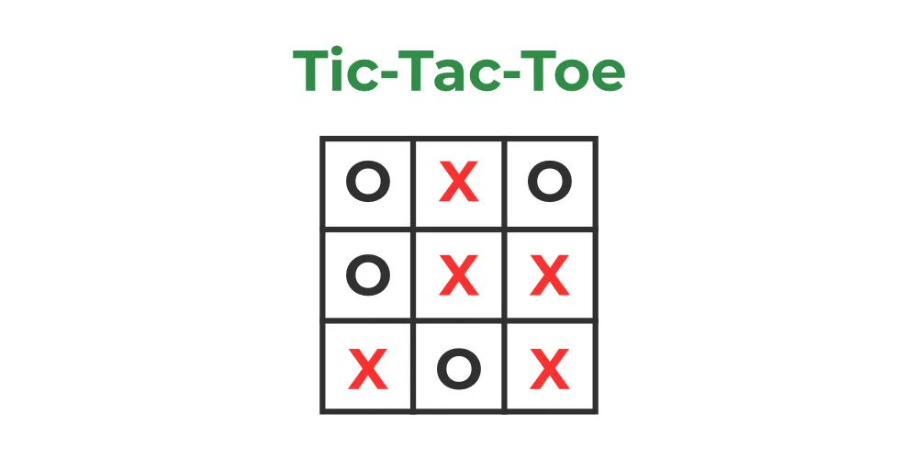
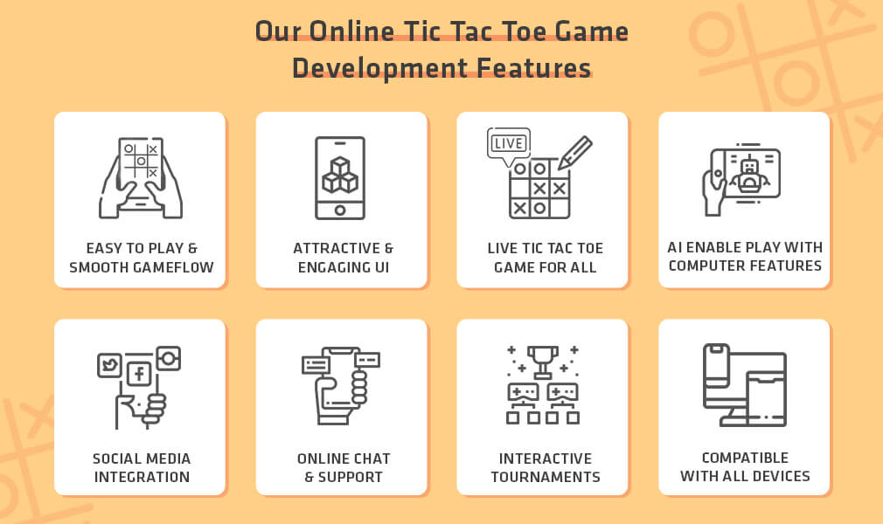
Tools and Technologies Used
The development of the Tic-Tac-Toe game involved the use of the following technologies.
NOTE : YOU CAN REPLACE THE TOOLS ABOVE BASED ON WHAT YOU ACTUALLY USED.

Slide 5
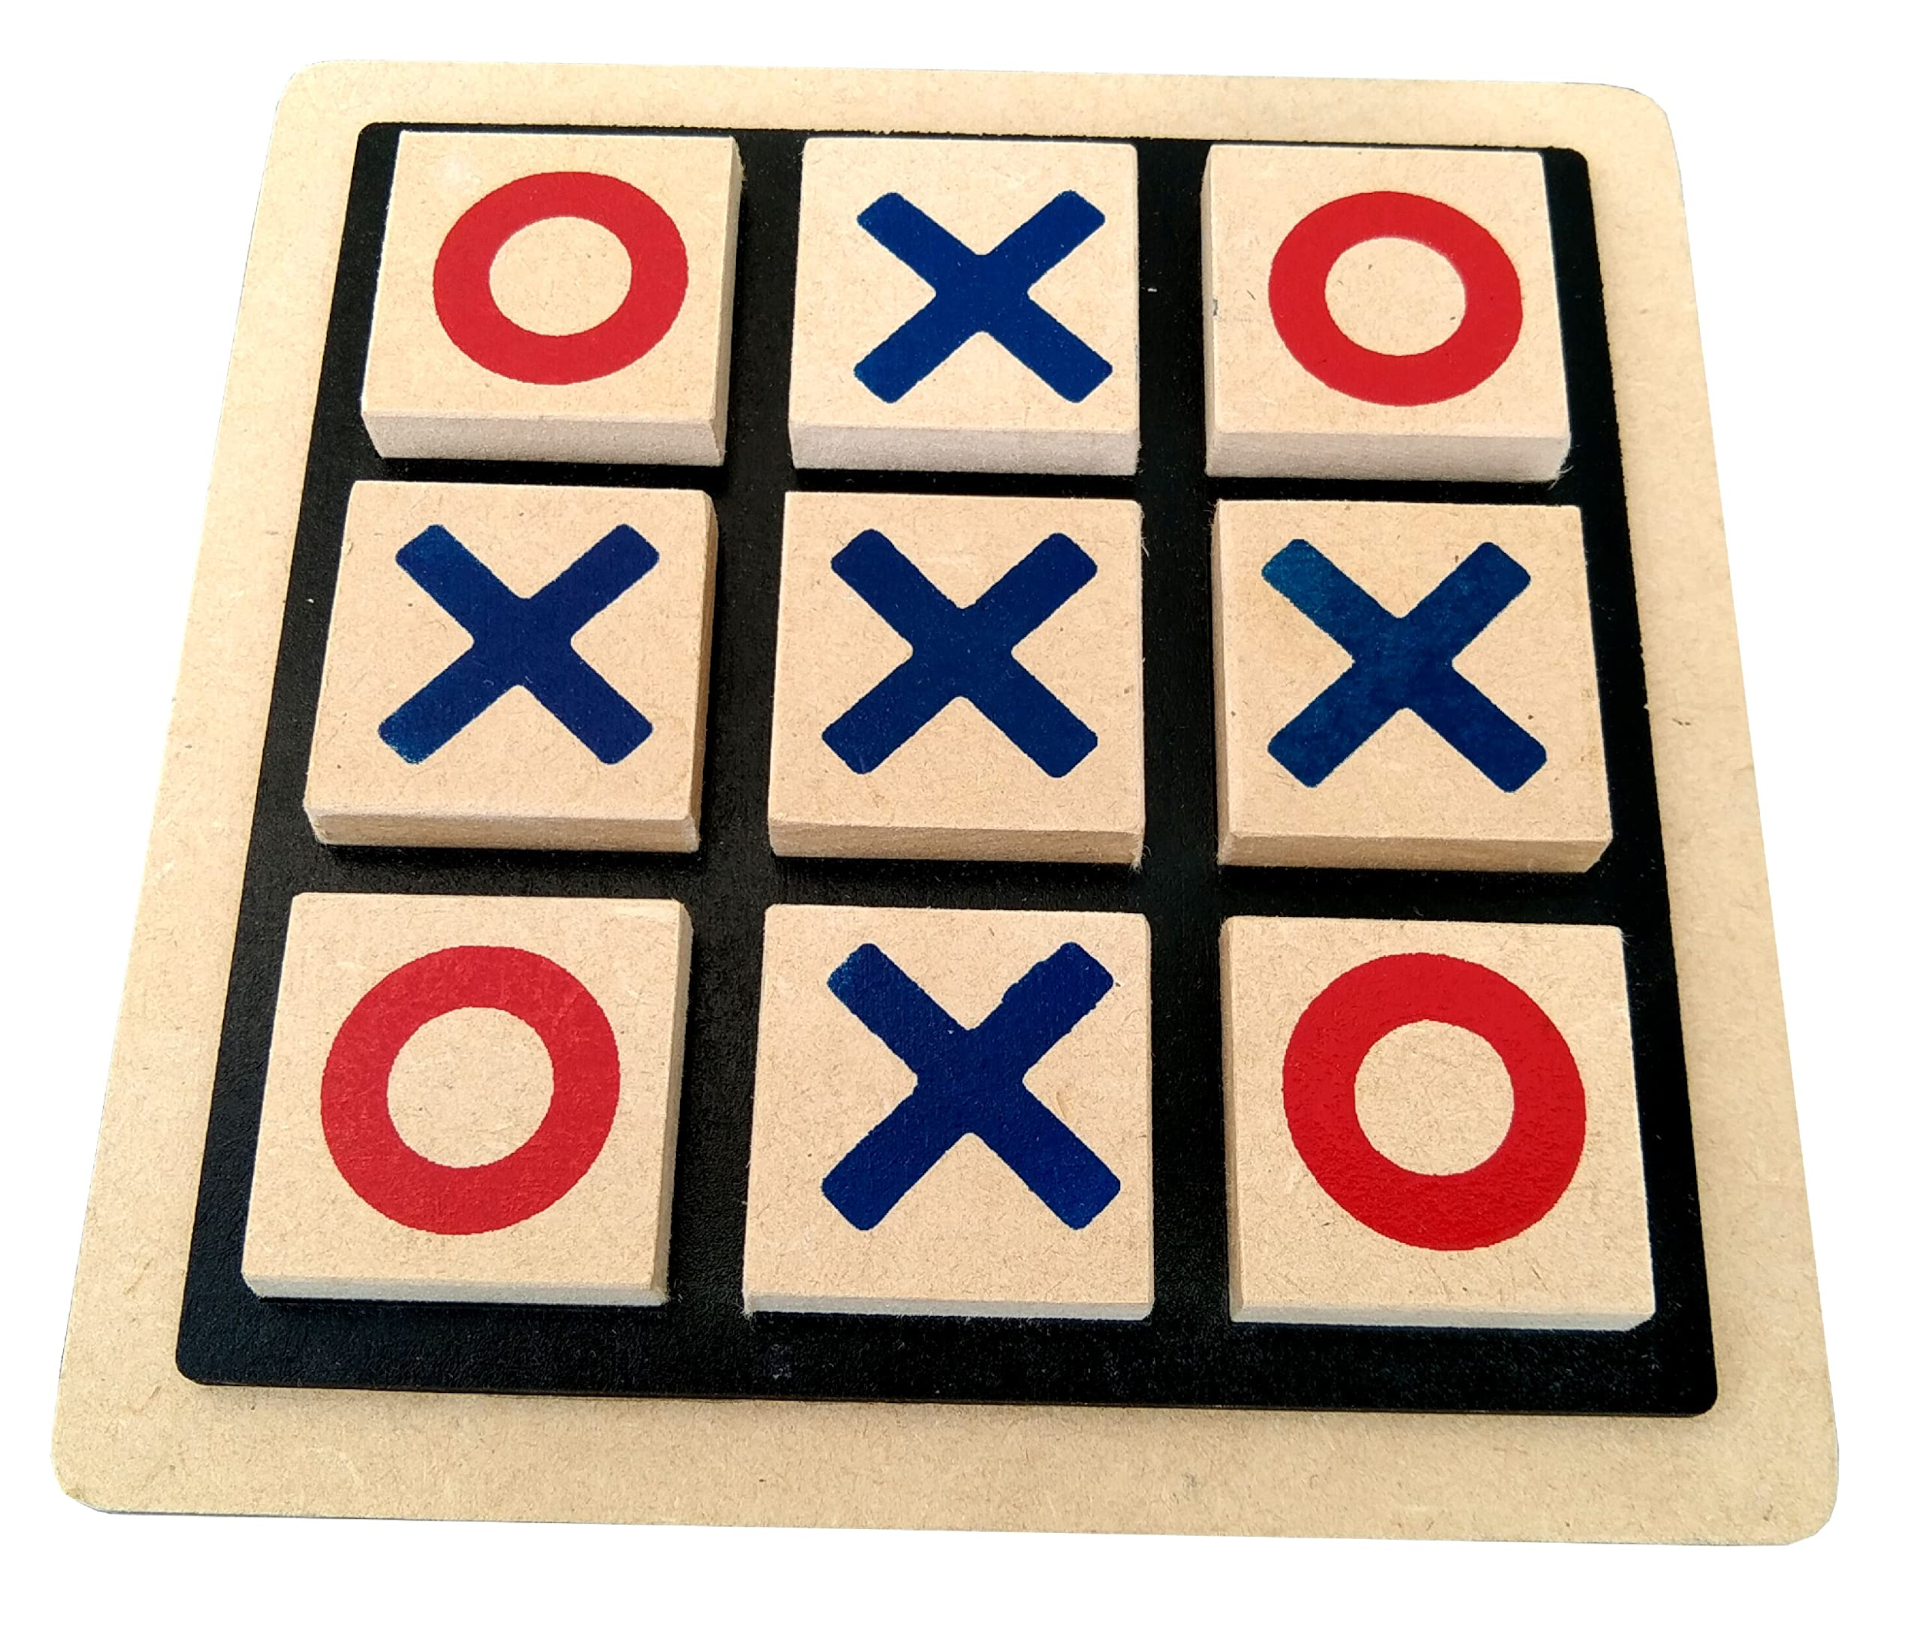
SYSTEM DESIGN AND ARCHITECTURE
Game Flow:
The game starts with an empty 3x3 grid.
Players alternate turns, marking either X or O in the cells.
After each move, the system checks for a win or draw.
If a player wins or the grid is filled (draw), the game ends with a message.

Slide 6
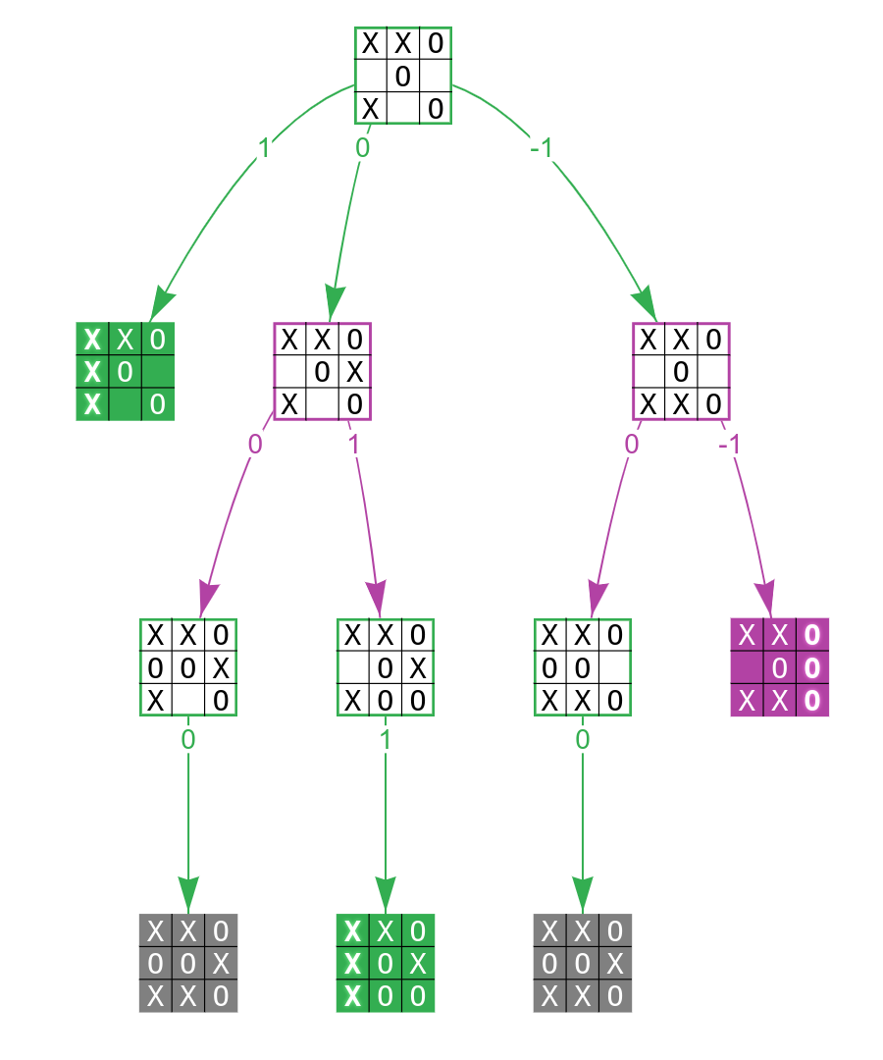
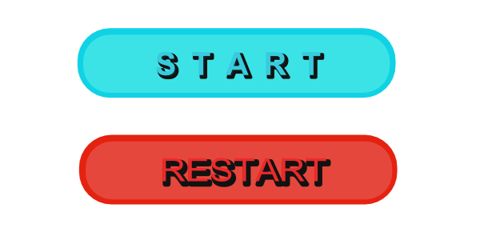
User Interface :
Clean and minimalist design
Start/Restart button
Player turn display
Result pop-up or message after win/draw

Slide 7
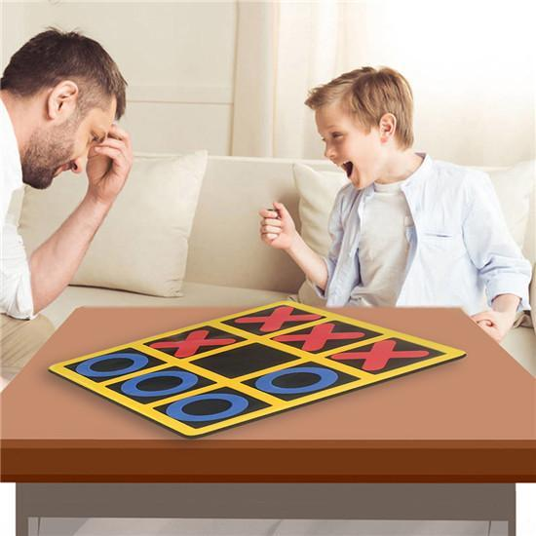
Implementation Details
1. LOGIC :
A 2D array (or a single list) is used to track the game state.
A function checks all rows, columns, and diagonals after each move.
A move is considered valid only if the cell is empty.
2. KEY FUNCTIONS :
check_winner(): Verifies if a player has won.
check_draw(): Checks if the game is a draw.
reset_game(): Resets the grid for a new match.
3. CODE STRUCTURE :
Main File: Handles UI and game loop
Logic Module: Contains backend game logic
Assets: (if applicable) stores visuals/sounds

Slide 8
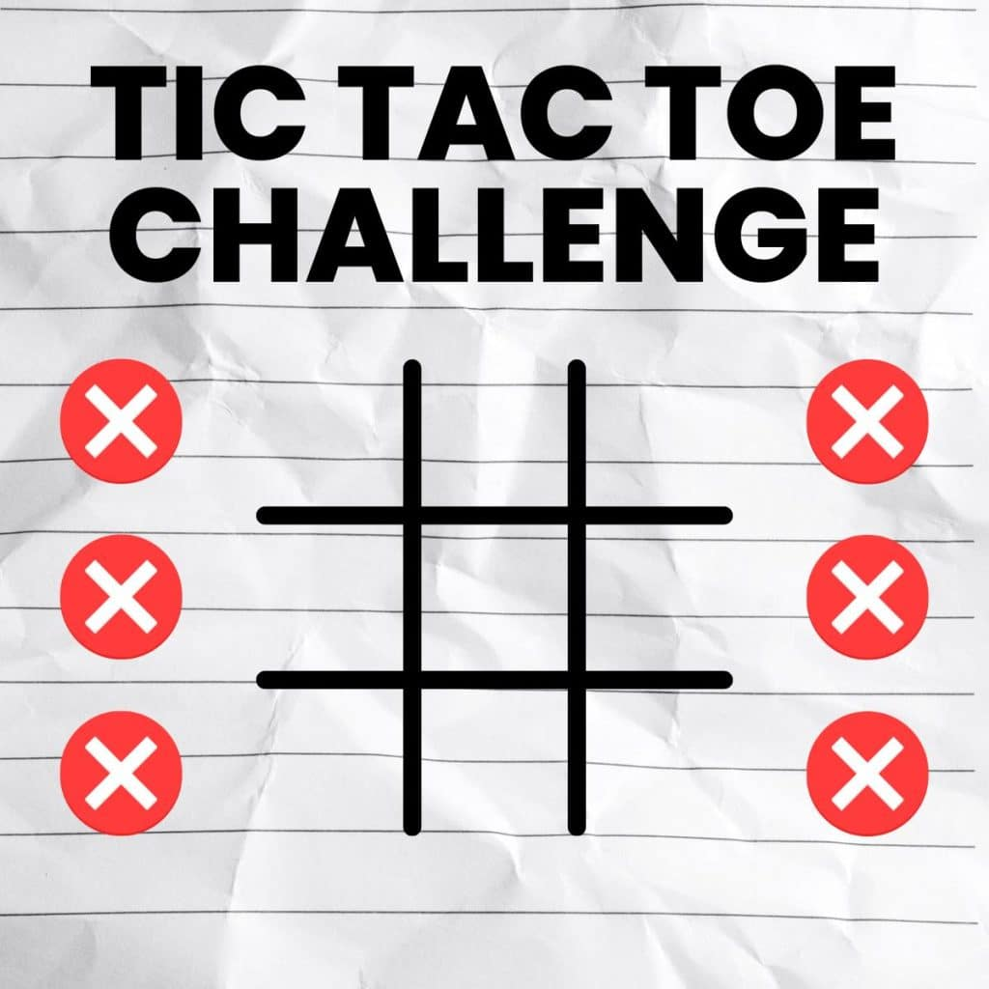
Challenges Faced
Managing UI responsiveness for different devices.
Handling edge cases (e.g., double-clicking same cell).
Ensuring real-time updates of player turns.
Debugging win-check logic for all conditions.

Slide 9
LEARNING OUTCOMES
This internship project taught me:
How to structure and manage a small-to-medium scale software project.
The importance of clean code and modular programming.
Hands-on experience in creating user-friendly interfaces.
Basics of software testing and debugging.
Effective use of version control systems.

Slide 10
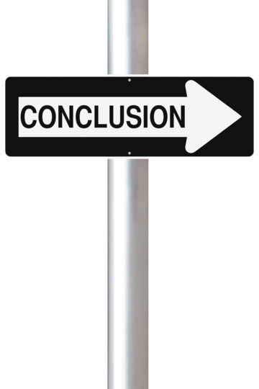
Conclusion
This Tic-Tac-Toe project helped me develop both technical and problem-solving skills.
Despite being a relatively simple game, the development process was rich in learning and practice.
From UI design to backend logic and from error handling to version control, the project gave me a real-world feel of software development.

Slide 11
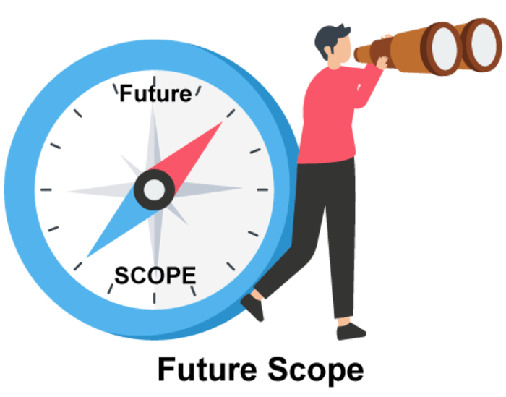
Future Scope
Some possible enhancements include:
Adding AI for single-player mode
Keeping track of scores over multiple rounds
Making the game responsive for mobile devices
Adding animations or sound effects for better user experience

